Slide 1
STRUCTURE OF SCIENTIFIC DOCUMENTS
STW EX20003
UNIT 04
MATHEMATICAL MATERIALS

Slide 2
WHAT ARE MATHEMATICAL MATERIALS
Numbers
Expressions involving basic arithmetic operations, variables, parameters, and constants used in mathematical models
Functions that work like mathematical operators
Subscripts and superscripts in a series of variables
Equations

Slide 3
CONSISTENCY IN WRITING
Consistency should be maintained throughout text e. g. writing 5000 in two places like this: 0.05 × 10⁵ in one place and 0.5 × 10⁴ in another, is inconsistent practice
Consistently, it should be stated as 5 × 10³

Slide 4
SI (Engineering) & Scientific Notation of Numbers
a × 10^{b}
a: Coefficient, 10: Base, b: Exponent
SI (Engineering) Notation
b takes values 0, 3, 6, 9, . . and –3, –6, . . .
Scientific Notation
0 < a < 10

Slide 5
SI Notation of Numbers Standard Scientific Notation
525 is written as 0.525 × 10³
0.005 is written as 5 × 10^{–3}
Standard scientific notations are preferred to computer exponentials e. g. 5.0 × 10⁻³ instead of 5.0 E−3
Computer exponentials (using E) appearing in computer output may be given in Appendixes, but not in main text
25.5 is represented as 2.55 × 10¹
0.055 is represented as 5.5 × 10⁻²

Slide 6
USE OF % SYMBOL COMPUND NUMBERS
% symbol is used with Indo-Arabic numbers
‘Per cent’ is used with word version of number e. g. 5 % and five per cent (not 5 per cent)
% symbol is not repeated with each number in a series or with each number in a range of values e. g. 5, 10, and 15 %, OR 5–10 %
Hyphen separates individual numbers of compound number and their ordinal counterparts e. g. twenty-one, thirty-four, . . . twenty-first, thirty-fourth, . . .

Slide 7
NUMERALS OR WORDS?
Numbers (nine or less) should be written in words e. g. We carried out two experiments . . .
If a series of numbers contain numbers both less and more than 10, then only Arabic numerals should be used e. g. There are 25 samples, with a sample size of 5.
Marks secured by the students are: 2, 5, 10, and 15.
Exception: We assume that x is greater than 1.

Slide 8
THOUSAND OPERATOR NUMBER OF MATHEMATICAL OPERATIONS
For very large and very small numbers, give a space in the thousand operator e. g. 10 000 000, 0.254 25
Always use figures when symbol of unit of measurement follows e. g. 5 A
Use figures when mathematical operations are implied e. g. factor of 2, 3 × 3 matrix

Slide 9
ROUND NUMBERS APPROXIMATE VALUES
Always spell approximate values, ‘round numbers’ e. g. about five years, two orders of magnitude, about four times larger
If approximate value is followed by a unit, then the unit is not expressed in symbols e. g. several kilovolts, a few tens of megahertz, a few volts

Slide 10
MODIFICATION OF NOUN
Units of measurement are nouns and should not be used to modify another noun:
Incorrect: The signal generator had a 15-kHz frequency.
Correct: The signal generator had a frequency of 15 kHz.
Incorrect: It is a 6-centimeter long pipe.
Correct: The length of the pipe is 6 cm.

Slide 11
LIST OF SYMBOLS
Research document should contain list of symbols in the beginning
List of symbols helps to
To ensure that same symbol is neither used for more than one purpose nor defined in more than one way
Reader to refer to one place to find definition of a symbol
List of symbols should be arranged with Latin letters followed by Greek letters, each arranged alphabetically
Whenever applicable, unit of measure should be given for each symbol:
c: Velocity (km/h)
m: Mass (kg)
. . .
β: Regression coefficient (unit/rupee)
η: Efficiency (1)

Slide 12
BASIC ARITHMETIC OPERATIONS
Signs for basic arithmetic operations:
Plus +
Minus − (different from hyphen - look at length, vertical location, and intensity)
Multiplication × (different from the letter x or symbol asterisk *)
Division ∕ (different from solidus i. e. slash or oblique / look at the inclination) and ÷
Except plus symbol, no symbol is available on a keyboard normally available in the market
All other symbols are to be selected from Symbols list

Slide 13
SCALARS, VECTORS, AND MATRICES
Scalars, vectors, and matrices are written as follows:
scalar: lightface italic (v, l, m, … )
vector: boldface, lower-case (v, l, m, … )
matrix: boldface, upper-case (V, L, . . .)
tensor: boldface, italic (V, L)
Purpose of italicizing scalars is to distinguish them from SI units that are always written upright

Slide 14
VARIABLES & CONSTANTS
Symbols for variables, constants, and unknown quantities are italicized e. g. x, l, m
Greek letters ( α, β, etc.) are always written upright
Greek letters ( α, β, etc.) are always set in Roman
Subscripted variables follow different writing styles:
Subscripts are numbers: x₁, x₂
Subscripts are variables: x_{i}, x_{ij}
Subscript is upright when it refers to input or output variable or entities
other than a quantity e. g. x_{i} (input variable), x_{o} (output variable), x_{e} (mass of electron)
Subscript is upright when it refers to values of upper and lower limits or maximum and minimum values e. g. x_{u} and x_{l} , x_{max} and x_{min}

Slide 15
Abbreviations for standard functions, such as log, max, min, exp, sin, cos, tan, cosh, lim, avg, cov, diag, and ln, are set in Roman (upright)
A space separates function name from expression e. g. log x, sin (x + y), . . .
Operators for expectation and transposition are in italic e. g. E and T
FUNCTIONS
&
OPERATORS

Slide 16
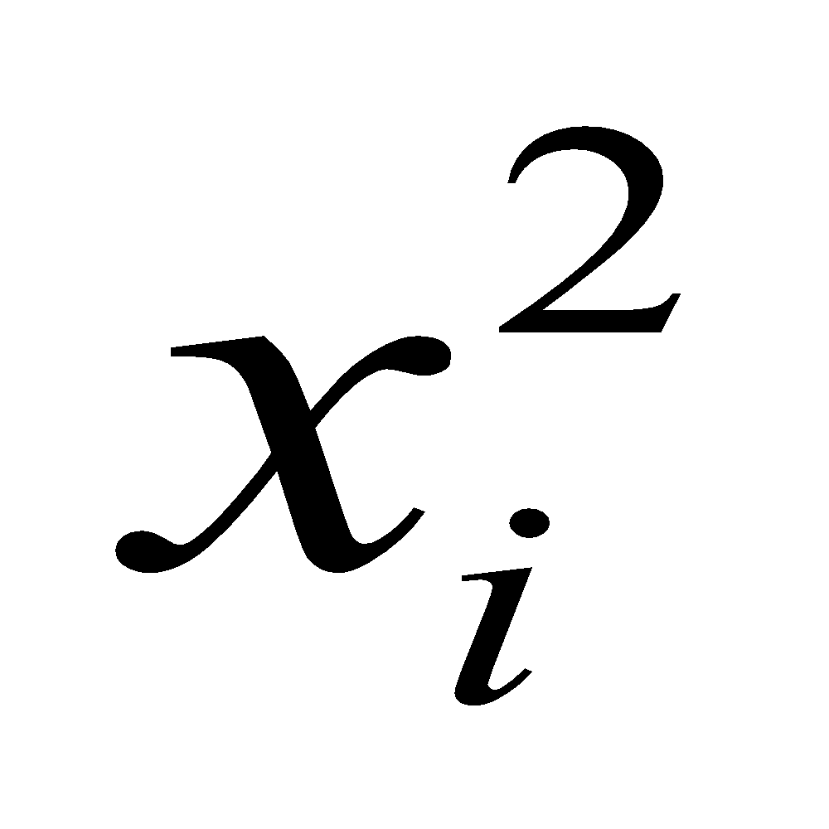
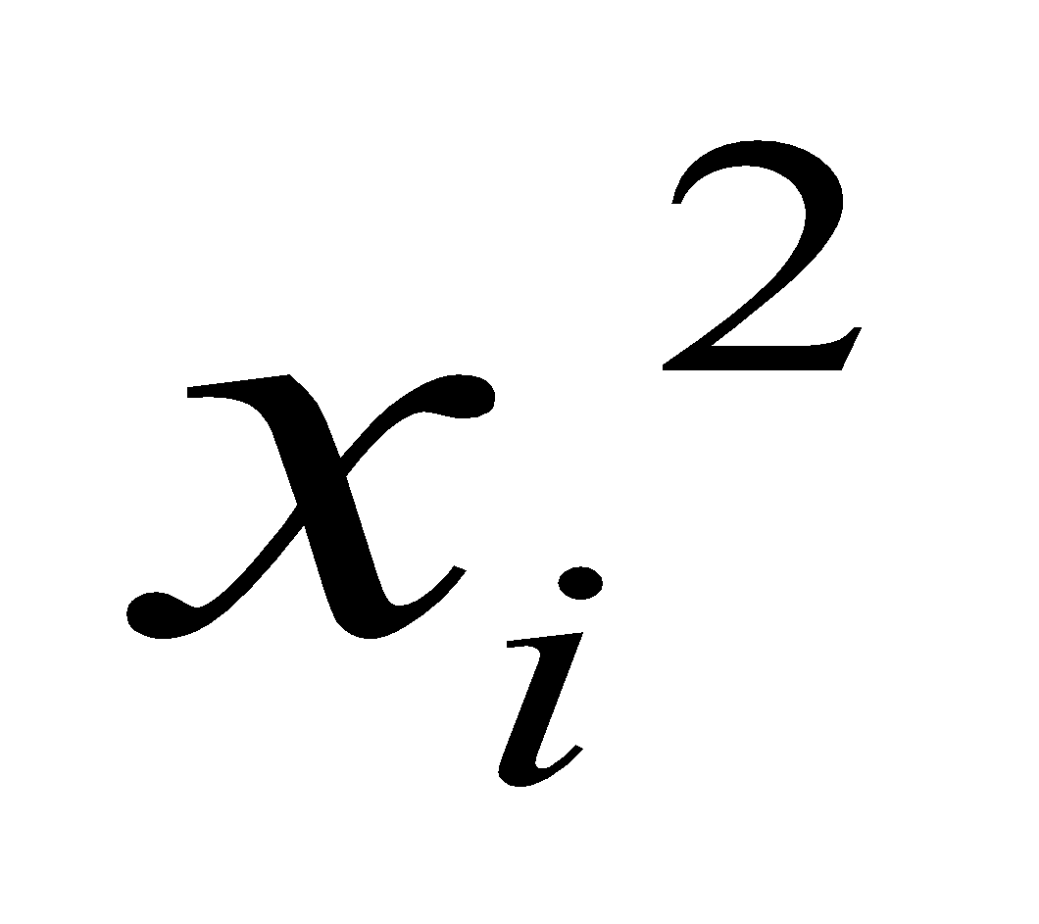
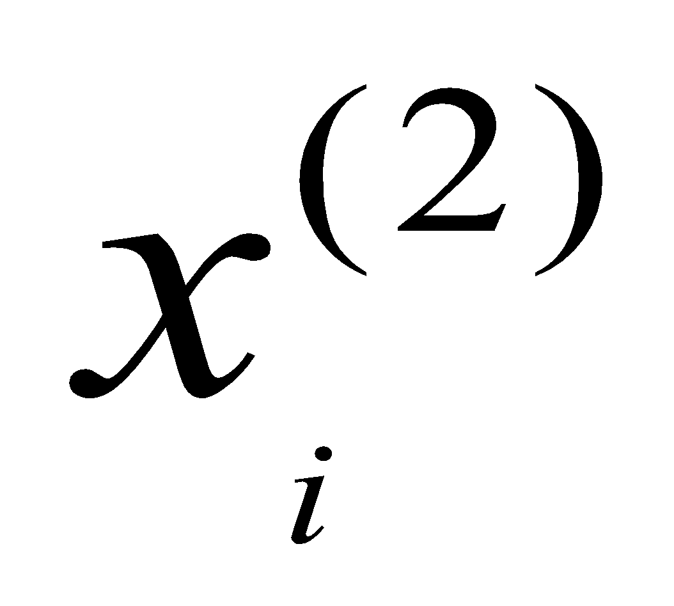
Transpose of a vector
x^{T}(n) not x(n)^{T}
Power of a scalar
x²(n) not x(n)²
Vertical alignment of superscript and subscript
not
Indexing a subscripted variable:
not
SUPERSCRIPTS

Slide 17
USE OF ELLIPSES
Ellipsis indicate omitted words, sentences, or symbols
Ellipses indicate a series of variables e. g.
x₁, x₂, . . ., x_{n} (not x₁, x₂ . . . x_{n})
Three raised ellipses (centered dots) are used for series of additions or multiplications of variables e. g.
x₁ + x₂ + · · · + x_{n} (not x₁ + x₂ + . . . x_{n})
x₁x₂ · · · x_{n} (not x₁x₂ . . . x_{n})
Three ellipses indicate range of variable e. g.
x_{i}, i = 1, 2, . . . (not x_{i}, i = 1, 2 . . .)

Slide 18
One space should be provided on both sides of a mathematical operator
z = x + y z = x − y
z = x × y z = x ÷ y
No space appears if division is indicated by the symbol ∕ and also when multiplication is implied
z = x∕y z = xy z = 25x
Negative number should not have space separating sign and number
The number −2 (not − 2) is more than −3 (not − 3).
−3 < −2 (correct) − 3 < − 2 (not correct)
When plus sign indicates positive number then no space appears between sign and number
−3 ≤ x ≤ +3
No space appears between a variable and its subscripts (or superscripts) and between a variable and its power
x_{i}, x_{ij}, x²
SPACE ACCOMPANYING MATHEMATICAL OPERATORS

Slide 19
REFERENCING EQUATIONS
Each equation should appear immediately after it is referenced in text for first time
Explanation for each equation should appear in text that precedes it
Explanation should define important variables and their relationships that lead to equation
Subsequent referencing takes place by citing equation number
All symbols appearing in equation should be defined immediately after
Symbols should be sequenced in order of their appearance in equation
Unambiguous definitions should be given along with units of measure (wherever applicable)

Slide 20
EXPLANATION OF TERMS EQUATION NUMBER LOCATION OF EQUATION
A long equation can have many terms, each representing a particular aspect of theme of equation
Each term should be explained before or immediately after equation
***
Equations are referred to in text by equation numbers
Equations are numbered in order of appearance (like tables and figures)
When document is divided into chapters, equation number bears chapter number and number reflecting order of appearance
***
Equation should be separated from texts preceding and following it by a larger line spacing (compared to one in text)
It should be set off from left margin with an indentation
Equation numbers should be right justified and should be preceded by three raised ellipses

Slide 21
EXAMPLES
Number of students (z) in class is given in Eq. 4.2 as sum of number of male students (x) and number of female students (y):
z = x + y · · · (4.2)
This equation is second in order of appearance in Chapter 4 of document
Note abbreviation “Eq.” used in text preceding equation
Concentration = (ma’ + b) × dilution factor
where a’: unknown sample absorption
m: slope of calibration graph
b: intercept on concentration axis
Note: ‘where’ is not capitalized

Slide 22
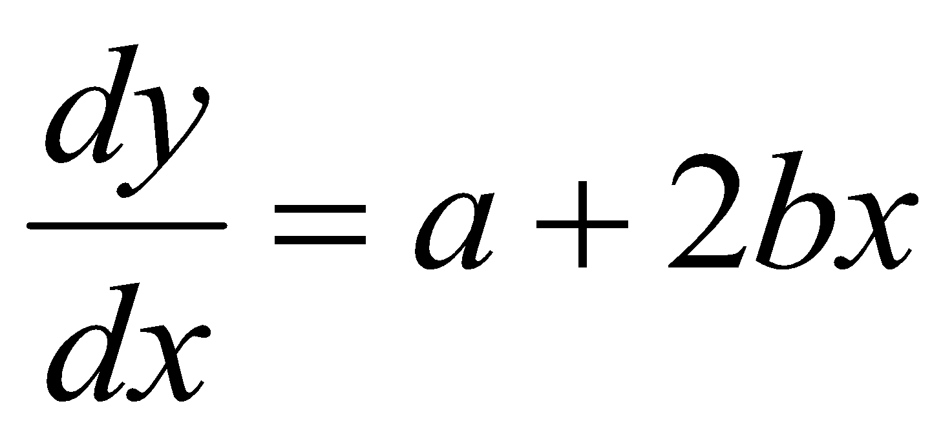
PUNCTUATION
Equations should be punctuated as a sentence e. g.
Defining y as a quadratic function of x,
y = ax + bx², · · · (3)
the gradient of y is given as
. · · · (4)
Note: commas, full stop, raised dots, vertical alignments

Slide 23
PARAMETERS IN EQUATIONS EQUATION IN TEXT LINE
Not numbers but parameters appear in equations (because they are estimated values and not constants):
Not recommended: z = x + 2
Recommended: z = x + y y = 2
A numbered equation should not appear in a line in the text
Incorrect: It thus comes out to be true that x² + y = x + y² · · · (4.3)
Correct: Thus the following equation holds:
x² + y = x + y² · · · (4.3)

Slide 24
BREAKING EQUATIONS
Long equation may not fit in one line, and may be broken in two ways:
before verb operator (such as =, ≠, <, >, ≤, ≥) or
before conjunction (such as +, ×) that follows an aggregation (i. e. meaningful expression within brackets)
In first case, run-over lines are aligned on verb operators
In second case, conjunction on run-over line is lined up with right of verb in line above
Verb Operator
Example:
z = (x + y – ef + r)
+ 2y – ef + r
– (e – f)
(x + y – ef + r)
< (2y – ef + r)
conjunction on run-over line

Slide 25
USE OF NUMBERS IN SENTENCES
Provide numerical values and avoid ambiguous words
Incorrect: The voltage across a forward-biased silicon diode is small.
Correct: The voltage across a forward-biased silicon diode is about 0.7 V.
Correct: The voltage across a forward-biased silicon diode is small (about 0.7 V).
Avoid dangling comparatives and superlatives
Incorrect: The voltage across the diode is smaller.
Correct: The voltage across the diode is smaller than the voltage across resistor R1.

Slide 26
FRACTIONS & MIXED NUMBERS USE OF HYPHENS
Incorrect Correct
3 ½ 3½
3½ kilograms 3-½ kilograms
3-1/2 kilograms
Incorrect Correct
A ten members committee A ten-member committee
25 inch cloth 25-inch cloth
5-A current 5 A current
3, 5, 10 ampere current 3-, 5-, 10-ampere current
1 foot long wire 1-foot-long wire

Slide 27
ORDERS OF MAGNITUDE
Same ‘order of magnitude’ means their ratio is less than ten e. g. 5 and 45 are of same order of magnitude
An order of magnitude larger means ten times as large e. g. 125 is an order of magnitude larger than 10
Two orders of magnitude larger means 100 times larger e. g. 825 is two orders of magnitude larger than 7

Slide 28
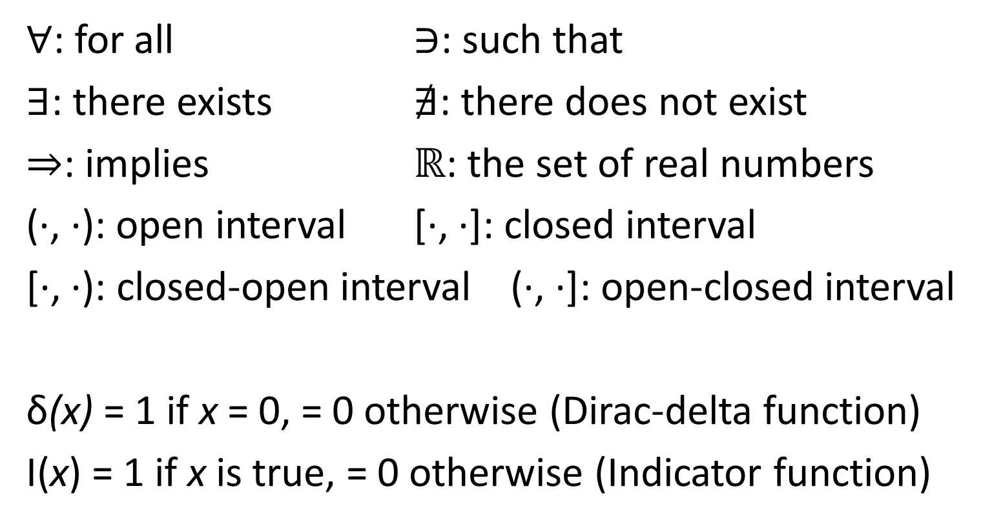
SPECIAL SYMBOLS

Slide 29
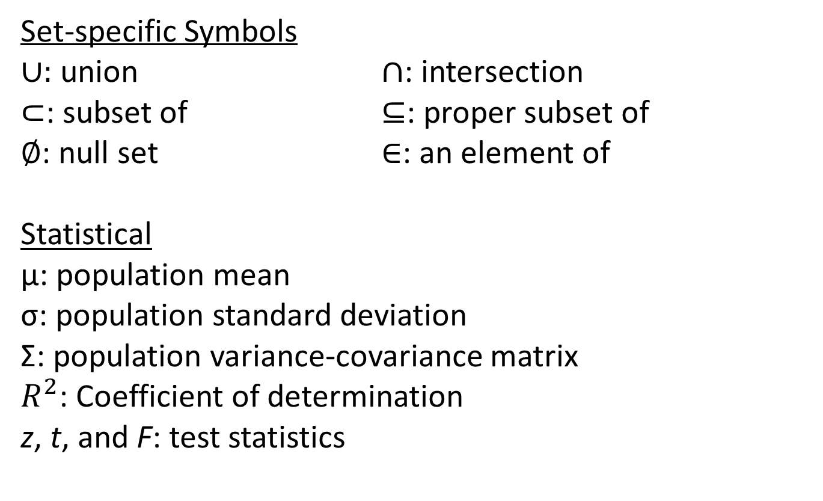
OTHER SYMBOLS

Slide 30
THANK YOU!

